Slide 2
Index
About Us
Mission and Vision
Strategic And Prudent Plans
Values
Key Observations
Key Members
Favorable Flavors
Faculties
Spectrum Of Education
Summary And Thanks

Slide 3
About Us
Himalayan University, being as a segment of quality higher education offers a wide range of degree programs at different levels of graduate, post graduate, doctorate and professional courses. Himalayan University is the first University to introduce B. Ed Programs under Special Education (LD) to support the Disable Students. Himalayan University is the first private university of Arunachal Pradesh to bring 5 Year Law Programs and has also introduced the School Of Pharmacy in the State of Arunachal Pradesh.
The university with an expertise team of faculties provides a unique platform for diverse and creative education while offering hundreds of degree programs in all major disciplines. On being accredited by the State government and UGC Act 1956, the Himalayan University is well versed to facilitate the tribal students with quality education and higher study programs of international standard in order to raise the literacy rate of the remote hilly locations of the nation.
Himalayan University intent to let their students to experience an International behavior while studying under the supervision of faculties of international repute. The University comprised of best team of faculties ranging from engineering, marketing, medical, media, pharmacy, education, law, nursing, agriculture and many more that have played a crucial role while imparting the root education while boosting the literacy rate of the tribal regions where students from these locations can easily find their livelihood without leaving within or beyond the boundaries of their hometown.

Slide 4
Mission
Enhancement To Research And Development Programs.
Synchronizing With Emerging Corporate Demands.
Come Up With Community Engagement.
Initiatives To Uplift The Tribal Regions in India.
Vision
Take Community View.
Pursue Ideas And Excellence With Energy.
Dynamic Platform For Innovative Education Mode.
Lead To Heighten The Women Higher Education.
To be As Benchmark For The Academic World.

Slide 5
Strategic And Prudent Plans
Career Orientation Programs
Broad Based Community Support
Advancement in Hill Regions of Arunachal Pradesh
Academic Research And Development Spectrum
Synchronization with Uprising Corporate World

Slide 6
Values
Innovative : Being valiant is a key to progress for every sector of the economy. Himalayan University is well fitted to bring new researches and development in order to face dynamic challenges of the education world.
Bridging : Himalayan University works to build worthy connection with corporate brands in order to offer best internship and training programs. Here, Himalayan University works to bring diversity and discipline while maintaining cordial relations.
Academic Freedom : Himalayan University respects individual beliefs and support student’s skills and capabilities where the students can prove best with their abilities and efforts.
Rigorous : Himalayan University always work to bring updates and creativity to the mode of learning. It expects to have high standard of quality education to turn their students effective to prove efficient in the corporate world.
Sustainable : Himalayan University maintains the level of faculties in respect of their knowledge and skills where these excellent staff and management would help in building a strong base to act actively in the global market.

Slide 7
Key Observations
Offer Platform To Embark on Most Interesting And Rewarding Careers.
Bringing Authentic and Effective Work Force Under One Roof.
Business Eco Strategy to Enhance The Standard Of Indian Corporate Force.
Initiatives To Promote Corporate Partnerships – Synergy

Slide 8
Key Members
Hemant Kumar Goyal, Founder & Chairperson, Himalayan University
Mr. Hemant Goyal (Founder Member; Global Jurix, Advocates & Solicitors), B.Com, L.L.B; associate attorney has been practicing for more than a decade. Apart from legal world; Mr. Hemant Goyal is deeply passionate about serving the community with exemplary services in academic wise. It is this passion that fuels his vision while establishing the Himalayan University in the tribal area of Arunachal Pradesh, with the aim to heighten the living standard of the hilly regions of the nation. Out of his striking academic perspective; Hemant Goyal enables the University to come over to its commitments while tagging with IAO accreditation, PHD Chamber of Commerce and Industry and AIMA Accreditation. On moving ahead with the same vision of strengthening the Girls Education System; Hemant Goyal being as Board of Directors; stated to offer 200 scholarships for the Tribal Girls for their Higher Education and offer wide range of degree programs in all major discipline to able the Tribal People to search their livelihood without leaving their hometown.
Mr P Subba Rao, Chancellor
Mr. Rao is Promoter and Managing Director of M/s. SS Energy Ventures Private Limited which is a niche renewable energy player holding sizable renewable port folio and is developing various wind, solar and hydro projects across the country. Mr Rao earlier established M/s. SSEV Naturo Farms Private Limited, with an objective to promote Organic and Natural farming techniques by making the Agricultural cultivation as Corporate Business. Mr. Rao is an MBA Post Graduate and is a commerce graduate with an additional degree in Law.

Slide 9
Favorable Flavors
Himalayan University Favors To Changing Academic Modes
The academic standard and the way of pursuing higher education have got immense changes as with due time. Earlier where distance and regular education modes had been placed a vital role in the academic world seems to get reserve gear and have easily been overtaken by Online Education. For instance, India is being transformed by population expansion and rising demand for online higher education. All the regions; we serve face new challenges in respect of offering quality education as a result of structural changes in national and global economies along with environmental and social challenges.
Our exceptional staff, sustainable and ethical approach and excellence in academic wise will definitely favors us in future to be act as leader against the benchmark for the best.
Contribution To The Community – Virtuous Base
Himalayan University offers 200 scholarships to support tribal girl education system in India. The main purpose of Himalayan University is to make the community where it enjoys the utmost level of quality higher education where the same community can able to develop their skills. Secondly, to offer an academic platform in order to come-over to social inequalities in respect of equal higher education to different classes of the society.

Slide 10
Faculties
Himalayan University has built its presence as one of the prestigious center of higher education in varied field and many at different level of higher education facets including graduate, post graduate, Ph.D and Post Doctorate programme. Himalayan University supports a total of 12 faculties that enable the students to choose the course as per their career goals and academic interest.
School of Social Science
School of Engineering & Technology
School of Business & Management
School of Computing and Information Technology
School of Pharmacy, Medical & Para-Medical Sciences
School of Hospitality and Tourism Management
School of Agriculture and Horticulture
School of Journalism and Mass Communication
School of Fine Arts and Creative Education
School of Commerce
School of Education School of Science School of Law School of Humanities & Languages School of Commerce

Slide 11
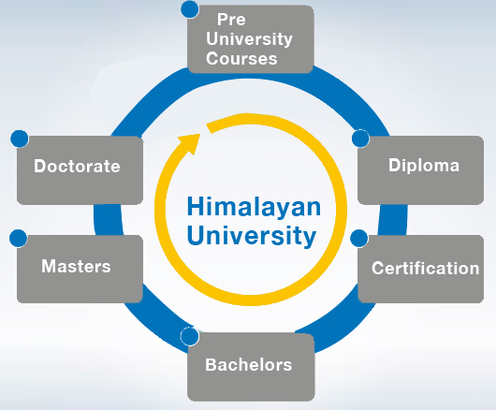
Complete Spectrum of Education
Himalayan University provides a complete spectrum of education starting from senior secondary and upto post doctorate degrees. To top it up, you have an option to choose from online or offline mode of education.

Slide 12
Summary
Aim To Have unprecedented growth in the next 5 years.
Building capacity to face any of the academic challenges.
Aim to achieve excellence at every level including Regional, National, World Class
Hallmark: Lead Role Player To Act As Benchmark for the Academic World.
Thanks

